Slide 1
Run-Time Environment Lecture 14-15

Slide 2
Run-time Environment
Compiler must cooperate with OS and other system software to support implementation of different abstractions (names, scopes, bindings, data types, operators, procedures, parameters, flow-of-control) on the target machine
Compiler does this by Run-Time Environment in which it assumes its target programs are being executed
Run-Time Environment deals with
Layout and allocation of storage
Access to variable and data
Linkage between procedures
Parameter passing
Interface to OS, I/O devices etc

Slide 3
Storage Organization
Compiler deals with logical address space
OS maps the logical addresses to physical addresses
Memory locations for code are determined at compile time. Usually placed in the low end of memory
Size of some program data are known at compile time – can be placed another statically determined area
Dynamic space areas – size changes during program execution.
Heap
Grows towards higher address
Stores data allocated under program control
Stack
Grows towards lower address
Stores activation records
Typical subdivision of run-time memory
Code
Static
Heap
Free Memory
Stack

Slide 4
Run-Time Environments
How do we allocate the space for the generated target code and the data object of our source programs?
The places of the data objects that can be determined at compile time will be allocated statically.
But the places for the some of data objects will be
allocated at run-time.
The allocation and de-allocation of the data objects is managed by the run-time support package.
run-time support package is loaded together with the generated target code.
the structure of the run-time support package depends on the semantics of the programming language (especially the semantics of procedures in that language).

Slide 5
Procedure Activations
Each execution of a procedure is called as activation of that procedure.
An execution of a procedure P starts at the beginning of the procedure body;
When a procedure P is completed, it returns control to the point immediately after the place where P was called.
Lifetime of an activation of a procedure P is the sequence of steps between the first and the last steps in execution of P (including the other procedures called by P).
If A and B are procedure activations, then their lifetimes are either non-overlapping or are nested.
If a procedure is recursive, a new activation can begin before an earlier activation of the same procedure has ended.

Slide 6
Call Graph
A call graph is a directed multi-graph where:
the nodes are the procedures of the program and
the edges represent calls between these procedures.
Used in optimization phase.
Acyclic € no recursion in the program Can be computed statically.

Slide 7
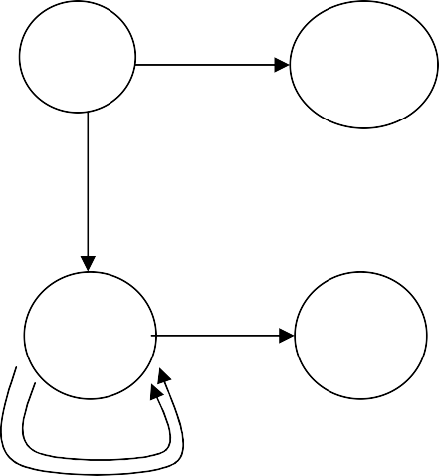
Example: Call Graph
var a: array [0 .. 10] of integer;
procedure readarray var i: integer begin … a[i] … end
function partition(y,z: integer): integer var i,j,x,v: integer begin … end
procedure quicksort(m,n: integer) var i: integer begin i := partition(m,n); quicksort(m,i-1); quicksort(i+1,n) end
Main
readarray
quicksort
partition
procedure main
begin readarray(); quicksort(1,9); end

Slide 8
Activation Tree/ Call Tree
We can use a tree (called activation tree) to show the way control enters and leaves activations.
In an activation tree:
Each node represents an activation of a procedure.
The root represents the activation of the main program.
The node A is a parent of the node B iff the control flows from A to B.
The node A is left to to the node B iff the lifetime of A
occurs before the lifetime of B.

Slide 9
Activation Tree (cont.)
program main; procedure s;
begin ... end; procedure p;
procedure q; begin ... end;
begin q; s; end; begin p; s; end;
enter main enter p enter q exit q enter s exit s
exit p enter s
exit s exit main
A Nested Structure

Slide 10
Activation Tree (cont.)
main
p
s
q
s

Slide 11
Activation Tree
Activation Tree - cannot be computed statically
Dynamic – may be different every time the program is run
main
r() q (1,9)
p (1,9) q(1,3) q (5,9)
p (1,3) q(1,0) q (2,3) p (5,9) q(5,5) q (7,9)
p (2,3)
q(2,1)
q (3,3)
p (7,9)
q(7,7)
q (9,9)

Slide 12
Run-time Control Flow
Paths in the activation tree from root to some node represent a sequence of active calls at runtime
main
r()
q (1,9)
p (1,9)
q(1,3)
q (5,9)
p (1,3)
q(1,0)
q (2,3)
p (5,9)
q(5,5)
q (7,9)
p (2,3)
q(2,1)
q (3,3)
p (7,9)
q(7,7)
q (9,9)

Slide 13
Implementing Run-time control flow
Procedure call/return – when a procedure activation terminates, control returns to the caller of this procedure.
Parameter/return value – values are passed into a procedure activation upon call. For a function, a value may be returned to the caller.
Variable addressing – when using an identifier, language scope rules dictate the binding.

Slide 14
Static Allocation
Historically, the first approach to solve the run-time control flow problem (Fortran)
All space allocated at compile time
Code area – machine instructions for each procedure
Static area / procedure call frame/ activation record
single data area allocated for each procedure.
– local vars, parameters, return value, saved registers
return address for each procedure.

Slide 15
Static Allocation
Data area
for procedure A
Data area
for procedure B
Code area
Code generated for A
return addr
return addr
Local data,
parameters, return value, registers for B
Local data, parameters,
return value, registers for A
Code generated for B

Slide 16
Call/Return processing in Static Allocation
When A calls B:
in A: evaluate actual parameters and place into B’s data area, place RA in B’s data area, save any registers or status data needed, update the program counter (PC) to B’s code
When the call returns
in B: move return value to known place in data area, update PC to value in RA
in A: get return value, restore any saved registers or status data

Slide 17
Static Allocation
Call tree: A
Code area
Activation for procedure A
Activation for procedure B
A:
PC
call B L1:
B:
… return
Local data, parameters,
return value, registers for A
Local data,
parameters, return value, registers for B

Slide 18
Static Allocation
Call tree: A
Code area
Activation for procedure A
Activation for procedure B
B
A:
PC
call B L1:
L1
B:
… return
Local for A
data
Local data for B

Slide 19
Static Allocation
Call tree: A
Code area
Activation
Activation
A:
 | for pro A | cedure |  | for procedure B
 |  |  |  | L1
 | Local for A | data |  | Local data for B
PC
call B L1:
B:
… return

Slide 20
Static Allocation: Recursion?
Code area
A:
call B
Activation for procedure A
Activation for procedure B
return addr
Local data for B
return addr
B:
Local for A
data
call B L2:
What happens???

Slide 21
Static Allocation: Recursion
Call tree: A
Code area
Activation for procedure A
Activation for procedure B
A:
call B L1:
PC
B:
call B L2:
return
Local for A
data
Local data for B

Slide 22
Static Allocation: Recursion
Call tree: A
Code area
Activation for procedure A
Activation for procedure B
B
A:
call B L1:
PC
L1
B:
call B L2:
return
Local for A
data
Local data for B

Slide 23
Static Allocation: Recursion
Call tree: A
Code area
Activation for procedure A
Activation for procedure B
B
A:
call B L1:
PC
B
L2
B:
call B L2:
return
Local for A
data
Local data for B

Slide 24
Static Allocation: Recursion
Call tree: A
Code area
Activation for procedure A
Activation for procedure B
B
A:
call B L1:
PC
L2
B:
call B L2:
return
Local for A
data
Local data for B

Slide 25
Static Allocation: Recursion
Call tree: A
Code area
Activation for procedure A
Activation for procedure B
B
A:
call B L1:
PC
L2
We’ve lost the L1 label so we can’t
get back to A
B:
call B L2:
return
Local for A
data
Local for B
data

Slide 26
Variable addresses hard-coded, usually as offset from data area where variable is declared.
addr(x) = start of x's local scope + x's offset
Runtime Addressing in Static Allocation

Slide 27
Stack Allocation
Need a different approach to handle recursion.
Code area – machine code for procedures
Static data – often not associated with procedures
Stack (Control Stack) – runtime information

Slide 28
Control Stack
The flow of the control in a program corresponds to a depth-first traversal of the activation tree that:
starts at the root,
visits a node before its children, and
recursively visits children at each node an a left-to-right order.
A stack (called control stack) can be used to keep track of live procedure activations.
An activation record is pushed onto the control stack as the activation starts.
That activation record is popped when that activation ends.
Dynamic – grows and shrinks
When node n is at the top of the control stack, the stack contains the nodes along the path from n to the root.

Slide 29
Activation Records
Information needed by a single execution of a procedure is managed using a contiguous block of storage called activation record.
An activation record is allocated when a procedure is entered, and it is de-allocated when that procedure exited.
Size of each field can be determined at compile time (Although actual location of the activation record is determined at run-time).
– Except that if the procedure has a local variable and its size depends on a parameter, its size is determined at the run time.

Slide 30
Activation Records (cont.)
The returned value of the called procedure is returned
in this field to the calling procedure. In practice, we may use a machine register for the return value.
The field for actual parameters is used by the calling procedure to supply parameters to the called procedure.
The optional control link points to the activation record of the caller.
The optional access link is used to refer to nonlocal data held in other activation records.
The field for saved machine status holds information about the state of the machine before the procedure is called.
The field of local data holds data that local to an execution of a procedure..
Temporary variables is stored in the field of temporaries.
return value
actual parameters
optional control link
optional access link
saved machine status
local data
temporaries

Slide 31
Activation Records (Ex1)
stack
main
p a:
q b:
program main; procedure p;
var a:real; procedure q;
var b:integer;
begin ... end; begin q; end;
procedure s;
var c:integer; begin ... end; begin p; s; end;
main
p
s
q

Slide 32
Activation Records for Recursive Procedures
program main; procedure p;
function q(a:integer):integer; begin
if (a=1) then q:=1;
else q:=a+q(a-1); end;
begin q(3); end; begin p; end;
main
p
a: 3 | q(3)
a:2 | q(2)
a:1 | q(1)

Slide 33
Stack Allocation for quicksort 1
Call Tree
Main readarray
Stack (growing downward)
Main
a: array
readarray
i: integer

Slide 34
Stack Allocation for quicksort 2
Call Tree
Main readarray quick(1,9)
Stack (growing downward)
Main
a: array
quick(1,9)
i: integer

Slide 35
Stack Allocation for quicksort 3
Call Tree
Main readarray quick(1,9)
Stack (growing downward)
Main
a: array
quick(1,9)
i: integer
quick(1,3)
i: integer
quick(1,0)
i: integer
p(1,9)
quick(1,3)
p(1,9)
quick(1,0)

Slide 36
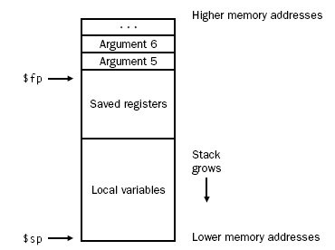
Layout of the stack frame
Frame pointer $fp: points to the first word of the frame,
Stack pointer ($sp): points to the last word of the frame.
The frame consists of
the memory between locations pointed by
$fp and $sp

Slide 37
Creation of An Activation Record
Who allocates an activation record of a procedure?
Some part of the activation record of a procedure is created by that procedure immediately after that procedure is entered.
Some part is created by the caller of that procedure before that procedure is entered.
Who deallocates?
Callee de-allocates the part allocated by Callee.
Caller de-allocates the part allocated by Caller.

Slide 38
Creation of An Activation Record (cont.)
return value
actual parameters
optional control link
optional access link
saved machine status
local data
temporaries
Caller’s Activation Record
Caller’s Responsibility
Callee’s Activation Record
return value
actual parameters
optional control link
optional access link
saved machine status
local data
temporaries
Callee’s Responsibility

Slide 39
Callee’s responsibilities before running
Allocate memory for the activation record/frame by subtracting the frame’s size from $sp
Save callee-saved registers in the frame. A callee must save the values in these registers ($s0–$s7, $fp, and $ra) before altering them
[since the caller expects to find these registers unchanged after the call.]
Register $fp is saved by every procedure that allocates a new stack frame.
$ra only needs to be saved if the callee itself makes a call.
The other callee-saved registers that are used also must be saved.
Establish the frame pointer by adding the stack frame’s size minus four to $sp and storing the sum in $fp.

Slide 40
Caller’s Responsibility
Pass arguments: By convention, the first four arguments are passed in registers $a0–$a3.
Any remaining arguments are pushed on the stack and appear at the beginning of the called procedure’s stack frame.
Save caller-saved registers: The called procedure can use these registers ($a0–$a3 and $t0–$t9) without first saving their value. If the caller expects to use one of these registers after a call, it must save its value before the call.
Execute a jal instruction which jumps to the callee’s first instruction and saves the return address in register $ra.

Slide 41
Call Processing: Callee
Initializes local data, calculate the offset of each variable from the start of the frame
The executing procedure uses the frame pointer to quickly access values in its stack frame.
For example, an argument in the stack frame can be loaded into register $v0 with the instruction
lw $v0, 0($fp)
Begins local execution

Slide 42
Callee’s responsibilities on returning
If the callee is a function that returns a value, place the returned value in a special register e.g. $v0.
Restore all callee-saved registers that were saved upon procedure entry.
Pop the stack frame by adding the frame size to
$sp.
Return by jumping to the address in register $ra.
Added at the ‘return’ point(s) of the function

Slide 43
Return Processing: Caller
Restore registers and status
Copy the return value (if any) from activation
Continue local execution
Added after the point of the call

Slide 44
Run time Addressing
Given a variable reference in the code, how can we find the correct instance of that variable?
Things are trickier – variables can live on the stack.
Tied to issues of scope

Slide 45
Storage and access for locally declared data
The executing procedure uses the frame pointer to quickly access values in its stack frame as the frame pointer points to the start of the frame.
Then add the variable’s offset from the start of the frame. Calculating local data’s offset (to be stored in the symbol table)
However problem arise for variable length data

Slide 46
Variable-Length Local Variables
Goal:
Allow a routine to have variable-length data
(i.e., dynamically-sized arrays) as local data in frame
Option 1:
Allocate the variable on the heap Work with pointers to the data
Auto free the data when the routine returns
Option 2:
Create the variable on the stack, dynamically Effectively: Enlarge the frame as necessary Still need to work with pointers

Slide 47
Variable Length Data
return value
actual parameters
optional control link
optional access link
saved machine status
local data pointer a pointer b
temporaries
array a array b
Activation record
for p
Control link and saved status
……… Pointer to a Pointer to b
….
Array a
Array b
Arrays
of p
Activation
record for q
top_sp
Control link and saved status
Arrays
of q
top
Variable length data is allocated after temporaries, and there is a link to from local data to that array.

Slide 48
Data Access Without Nested Procedures
Does not allow nested procedure declaration
Variables are either local or global
Allocation and access to variables are simple
Global variables
Allocated static storage
Locations remain fixed and known at compile time
Access possible using statically determined address
Local variables may be accesses using top_sp pointer

Slide 49
Scope
The scope of a variable is that portion of the programs to which the variable applies.
A variable is local to a procedure if the declaration occurs in that procedure.
A variable is non-local to a procedure if it is not local to that procedure but the declaration occurs in an enclosing scope of that procedure.
A variable is global if it occurs in the outermost scope.

Slide 50
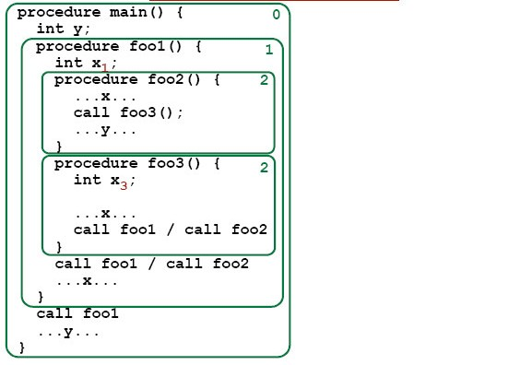
Local / Non-Local Variables

Slide 51
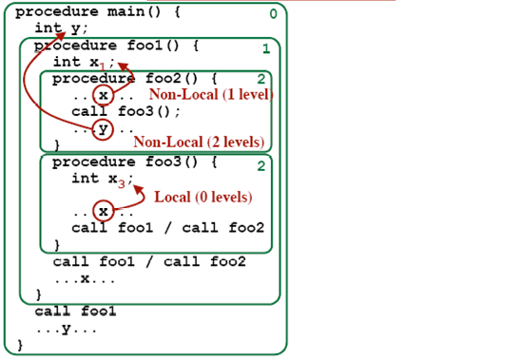
Local / Non-Local Variables

Slide 52
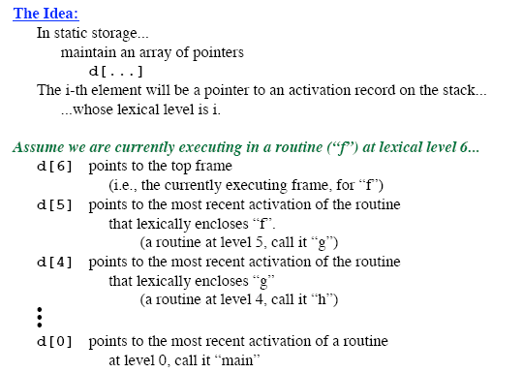
Display Registers

Slide 53
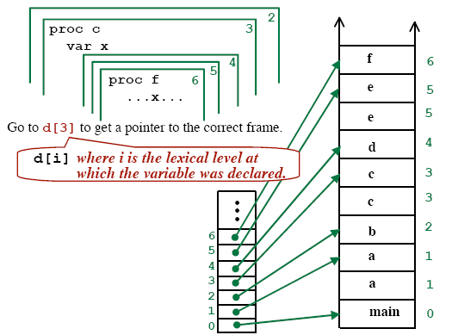
To access a non-local variable

Slide 54
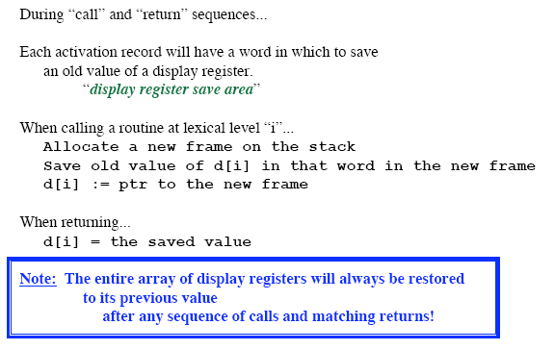
How to Maintain the Display Registers?

Slide 55
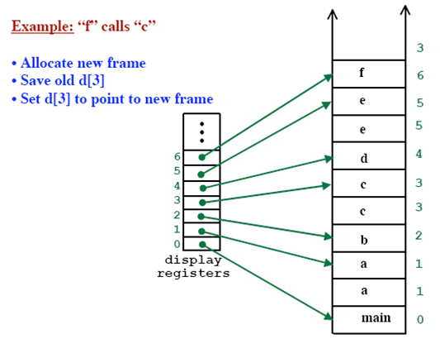
How to Maintain the Display Registers?

Slide 56
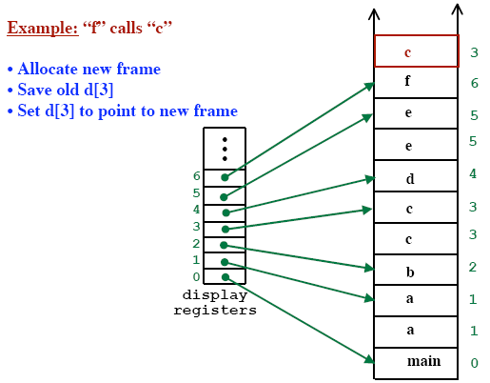
How to Maintain the Display Registers?

Slide 57
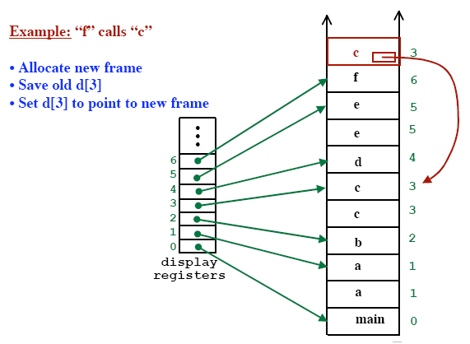
How to Maintain the Display Registers?

Slide 58
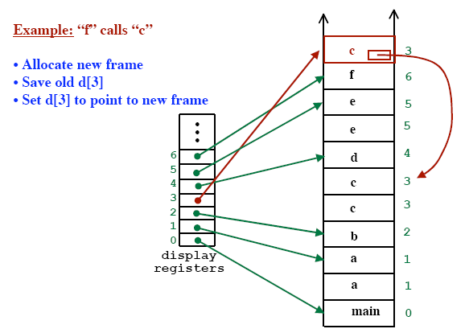
How to Maintain the Display Registers?

Slide 59
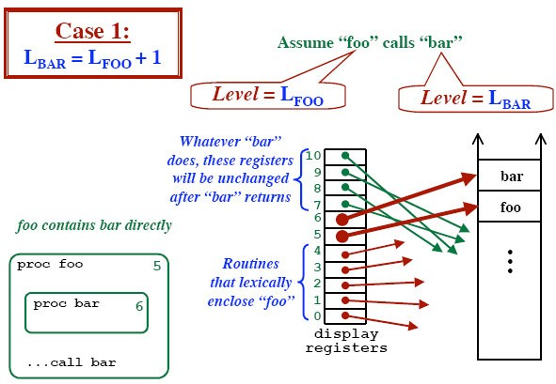
How to Maintain the Display Registers?

Slide 60
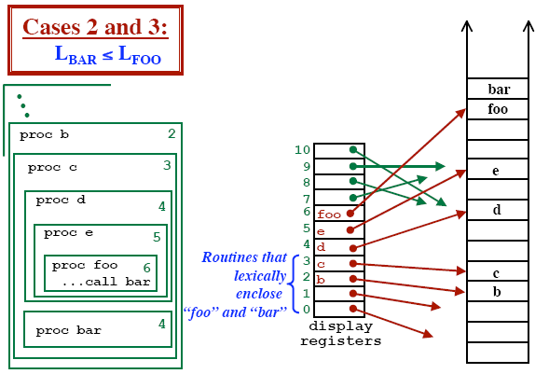
How to Maintain the Display Registers?

Slide 61
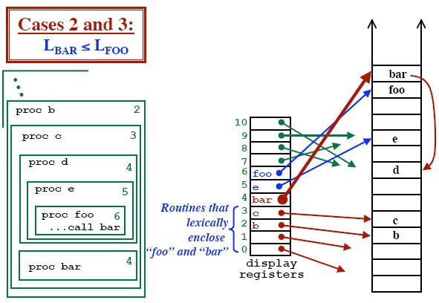
How to Maintain the Display Registers?

Slide 62
Parameter Passing
Various approaches to passing data into and out of a procedure via parameters
Call-by-value – data is copied at the callee into activation and any item changes do not affect values in the caller.
Ex: C parameters
Call-by-reference – pointer to data is placed in the callee activation and any changes made by the callee are indirect references to the actual value in the caller.
C++ - call-by-value and call-by-reference

Slide 63
Call-by-value vs Call-by-reference
var a,b : integer
procedure swap(x,y : integer); var t: integer;
begin t := x; x := y; y := t; end; begin
a := 1; b := 2;
swap(a,b); write ('a = ',a);
write ('b = ',b); end.
 | value | reference
write(a) | 1 | 2
write(b) | 2 | 1

Slide 64
Parameter Passing
Call-by-value-result (copy-restore) – hybrid of call-by-value and call-by-reference. Data copied at the callee. During the call, changes do not affect the actual parameter. After the call, the actual value is updated.
Call-by-name – the actual parameter is in-line substituted into the called procedure. This means it is not evaluated until it is used.

Slide 65
Call-by-value-result vs. Call-by-reference
var a: integer
procedure foo(x: integer);
begin a := a + 1; x := x + 1; end; begin
a := 1;
foo(a);
write ('a = ',a); end.
 | Value-result | reference
write(a) | 2 | 3

Slide 66
Call-by-name vs. Call-by-reference
var a : array of integer; i: integer procedure swap(x,y : integer); var t: integer;
begin t := x; x := y; y := t; end; begin
i := 1;
swap(i,a[i]);
write (‘i,a[i] = ’,i,a[i]); end.

Slide 67
Heap
Heap is used for data that lives indefinitely or until the program explicitly deletes it
Local variables become inaccessible when their procedures end
Many language enable us to create objects or other data whose existence is not tied to their procedure activations
– In C++/Java we can create objects using new keyword and may be passed to other procedures

Slide 68
Heap Management
Memory Manager
Allocates and deallocates space within the heap.
Serves as an interface between application programs and operating system
For some languages that need to deallocate space manually MM is responsible for implementing that.
Garbage Collector
Responsible for finding spaces within the heap that are no longer used by the program and the deallocate them
GC is an important subsystem of the memory manager

Slide 69
Memory Manager
Keeps track of all the free space in heap storage at all times.
Two basic functions
Allocation –
In response to some request MM produces a chunk of contiguous heap memory
If not possible then seeks to increase heap storage from virtual memory
Deallocation –
MM returns deallocated space to the pool of free space

Slide 70
Memory Manager
MM would be simpler if
All requests were for the same sized chunks
Storage were released in first-allocated first-deallocated style
BUT!! None is possible in most languages
MM should be prepared to
Serve requests in any order
Serve requests of any size

Slide 71
Properties of Memory Manager
Desired properties of MM
Space Efficiency
Should minimize the total heap spaced needed
Can be achieved by minimizing fragmentation
Program Efficiency
Should make good use of the memory to allow program to run faster
Should take advantage of ‘locality’ characteristics of program
Low Overhead
Allocation and deallocation operations should be as efficient as possible

Slide 72
Memory Hierarchy
Typical Sizes
Typical Access Times
> 2 GB
Virtual Memory (Disk)
3-15 ms
256MB-2GB
Physical Memory
100-150ns
128KB-4MB
2nd-Level Cache
40-60ns
16KB-64KB
1st-Level Cache
5-10ns
32 Words
Registers (Processor)
1ns
Registers are managed by the generated code
All other levels are managed automatically
With each memory access the machine searches each level of the memory in succession starting from the lowest level

Slide 73


Fragmentation
Variable-sized chunks of memory are allocated.
Some chunks are freed (in more-or-less random order).
The resulting free space become “fragmented”.
Need to allocate more space?
Adequate space is available
... but it is not contiguous!
Holes
Even if holes are larger than the request
…. We need to split the hole
…. Creating yet smaller hole

Slide 74
Fragmentation Reduction
Control how the MM places new objects in the heap
Best-Fit Algorithm
Allocate the requested memory in the smallest available hole that is large enough
Spares larger holes for subsequent larger requests
Good strategy for real-life programs
First-Fit Algorithm
Object is placed in the first hole in which it fits
Takes less time to place objects
Overall performance is inferior to best-fit

Slide 75
Problems with Manual Deallocation
Two common mistakes
Memory Leak
Failing ever to delete data that will never be referenced
Slow down the program due to increased memory usage
Critical for long running/nonstop program such as OS or server
Does not affect program correctness
Automatic garbage collection gets rid of it
– Even the program may use more memory than necessary

Slide 76
Problems with Manual Deallocation
Two common mistakes
Dangling Pointer Reference
Delete some storage and try to refer to the data in the deallocated storage
Once the freed storage is reallocated any read, write or deallocation via dangling pointer can produce random effects
Dereferencing a dangling pointer creates program error hard to debug

